Slide 1
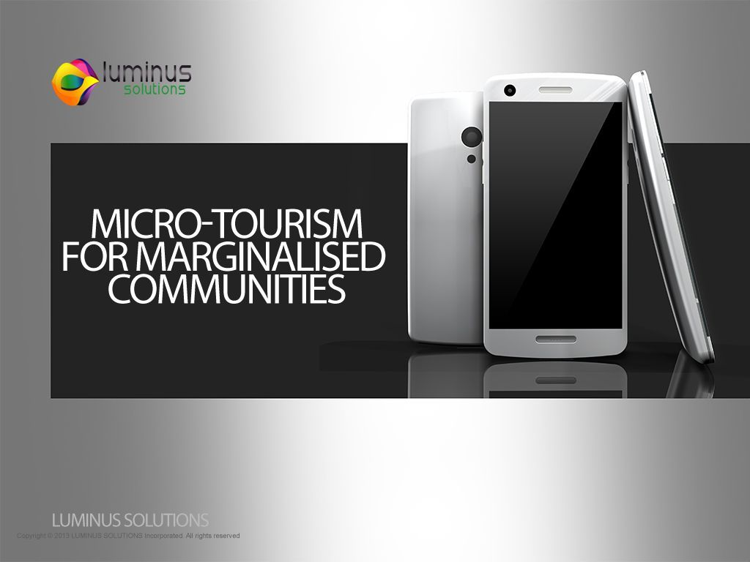
Micro- Tourism For Marginalized Communities

Slide 2

Luminus Solutions
Team Member | Role
NONHLANHLA MABUZA | SCRUM MASTER
ASHLEY GARDNER | ANALYST
NICOLAN REDDY | ANALYST
LWANDO SOBEKWA | DESIGNER
SINAKO CETYIWE | DESIGNER
SHANA-MICHELLE RABONDA | IMPLEMENTER

Slide 3
Project Objectives
To create a mobile application for the Dwesa community that will act as an enabler for change
To carry out systems analysis, design, and implementation while complying with all user requirements.
SCRUM Methodology

Slide 4
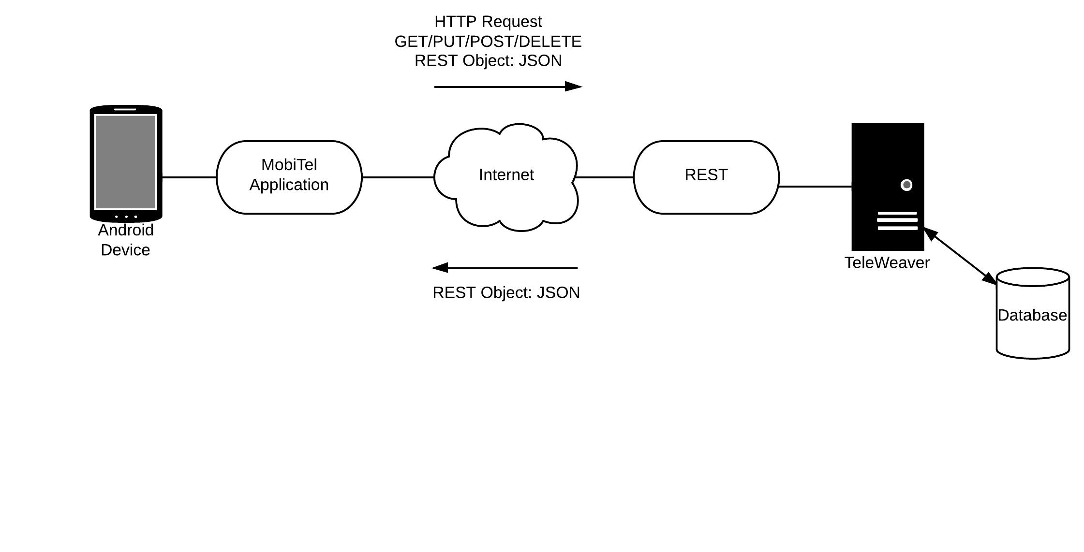
Project Overview

Slide 5
Micro-Tourism
Concerned with developing simple solutions which utilize the strengths of the environment within the local area to overcome the lack of utilities that are taken for granted.
Siyakhula Living Lab- ‘we are growing together’.
Luminus Solutions aims to facilitate the process of joining the Dwesa community with the greater South African community by developing a mobile android front-end for micro tourism.

Slide 6
Stakeholders
Siyakhula Living Lab
Reed House Systems
Dwesa Community

Slide 7
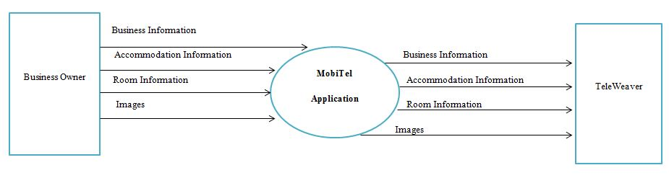
Context Diagram

Slide 8
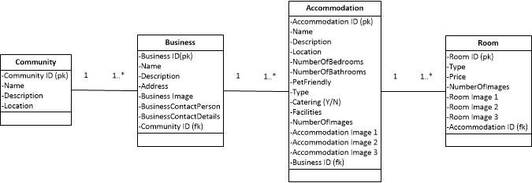
Analysis Class Diagram

Slide 9
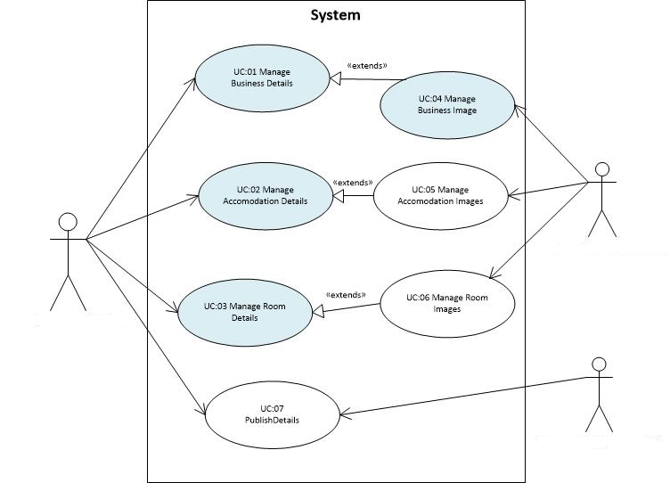
Analysis Use Case Diagram

Slide 10
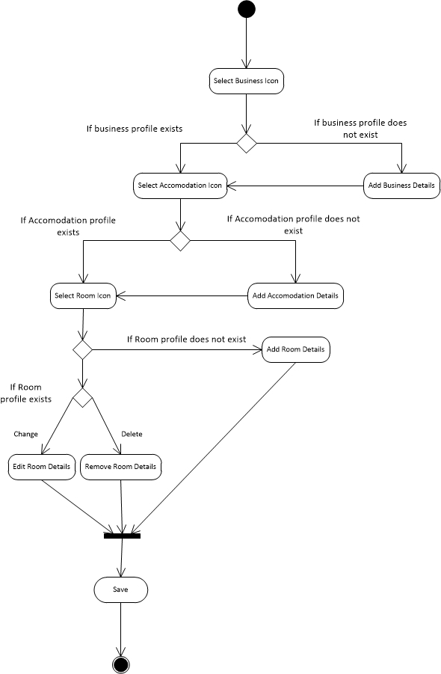
Overall Activity Diagram

Slide 11
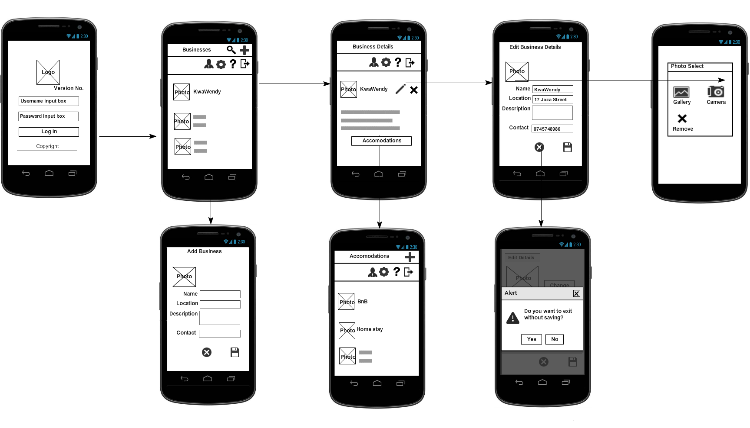
Wireframe Storyboard
Login Screen
Businesses Screen
Business Details Screen
Edit Business Screen
Photo Select Screen
Add Accommodation Screen
Accommodation Screen
Cancel Dialogue Screen

Slide 12
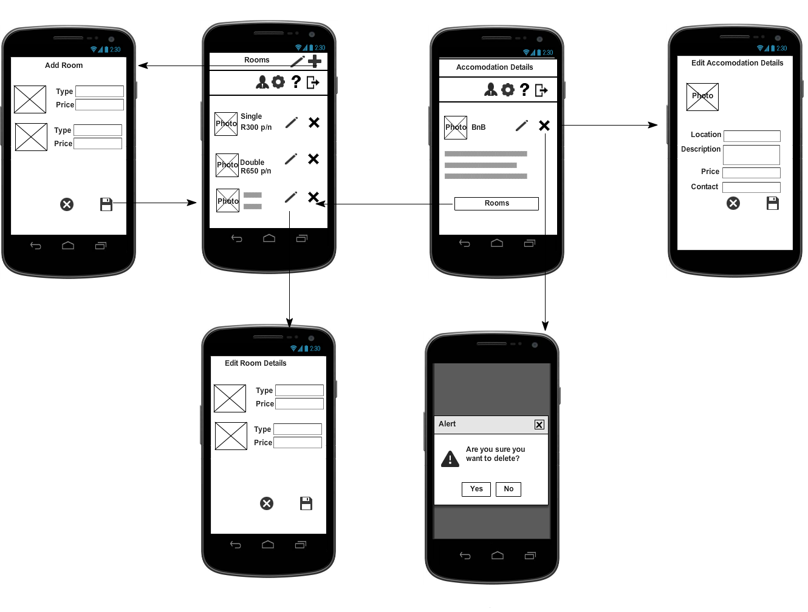
Wireframe Storyboard
Rooms Screen
Edit Accommodation Details Screen
Add Room Screen
Accommodation Details Screen
Edit Room Details
Delete Warning Dialogue

Slide 13
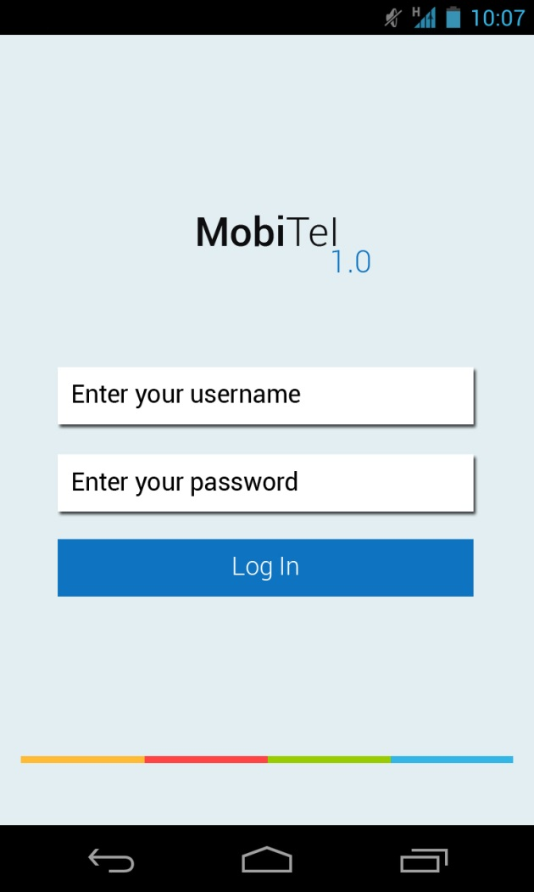
Screen Mock-ups

Slide 14
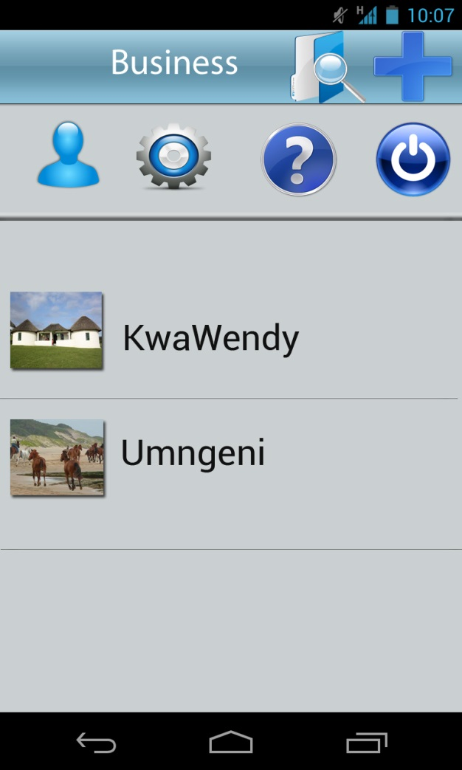
Mock-ups…Continued

Slide 15
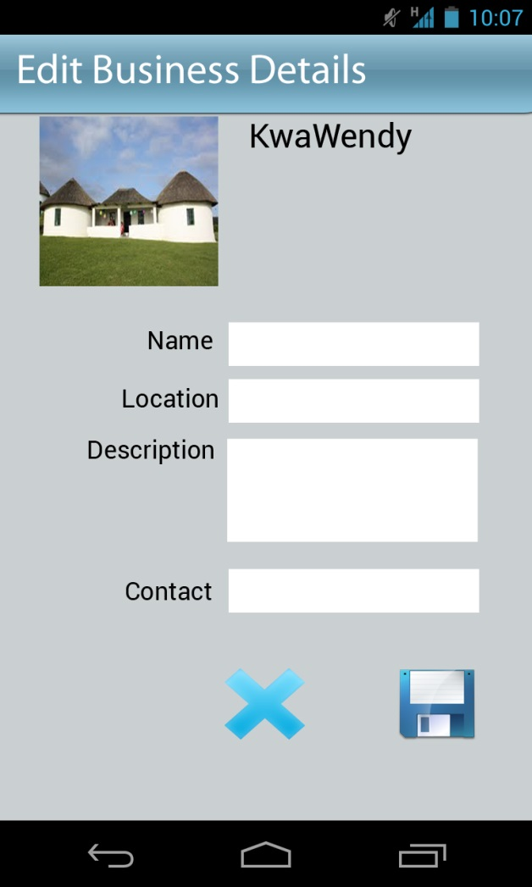
Mock-ups….Cont..(Editor Screen)

Slide 16

Implementation

Slide 17
Challenges
Scope
Users

Slide 18
Thank you!

